Slide 1

Data Engineering approach to job search
Alena Melnikova, Big Data Engineer
August 2018

Slide 2

Agenda
Intro
Job Search Pipeline 1.0
Building Job Search Pipeline 2.0

Slide 3

MOSCOW
HONG KONG
SINGAPORE

Slide 4
MOSCOW
HONG KONG
SINGAPORE

Slide 5
MOSCOW
HONG KONG
SINGAPORE

Slide 6
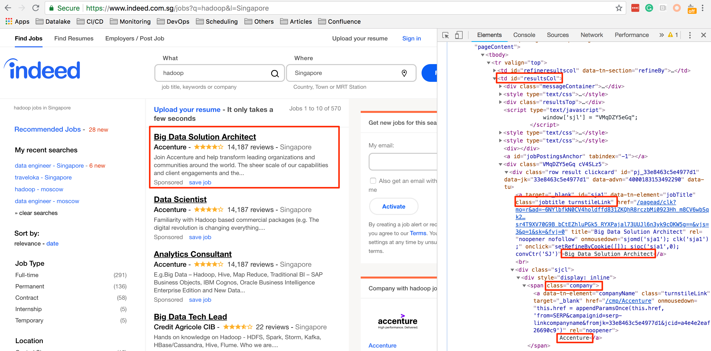

Slide 7
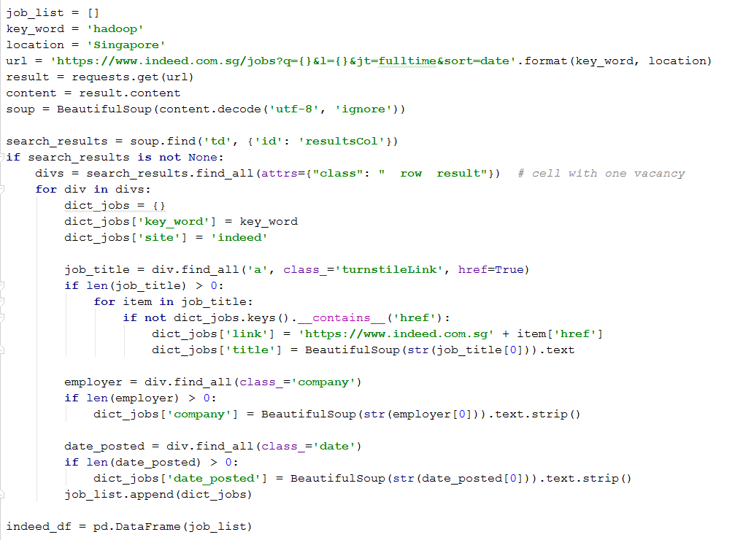

Slide 13
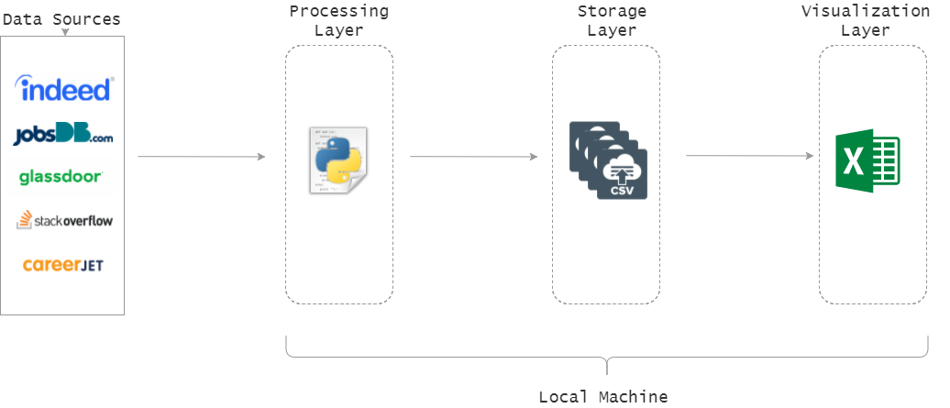
Pipeline Architecture 1.0
Python script
Output csv file
Excel

Slide 20
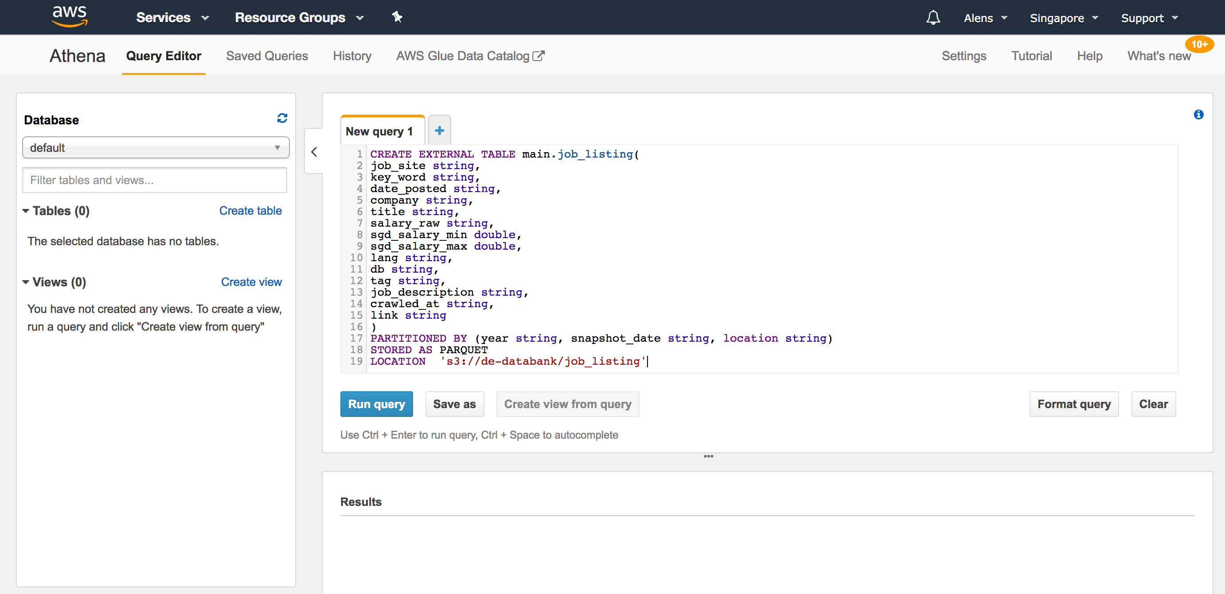

Slide 21
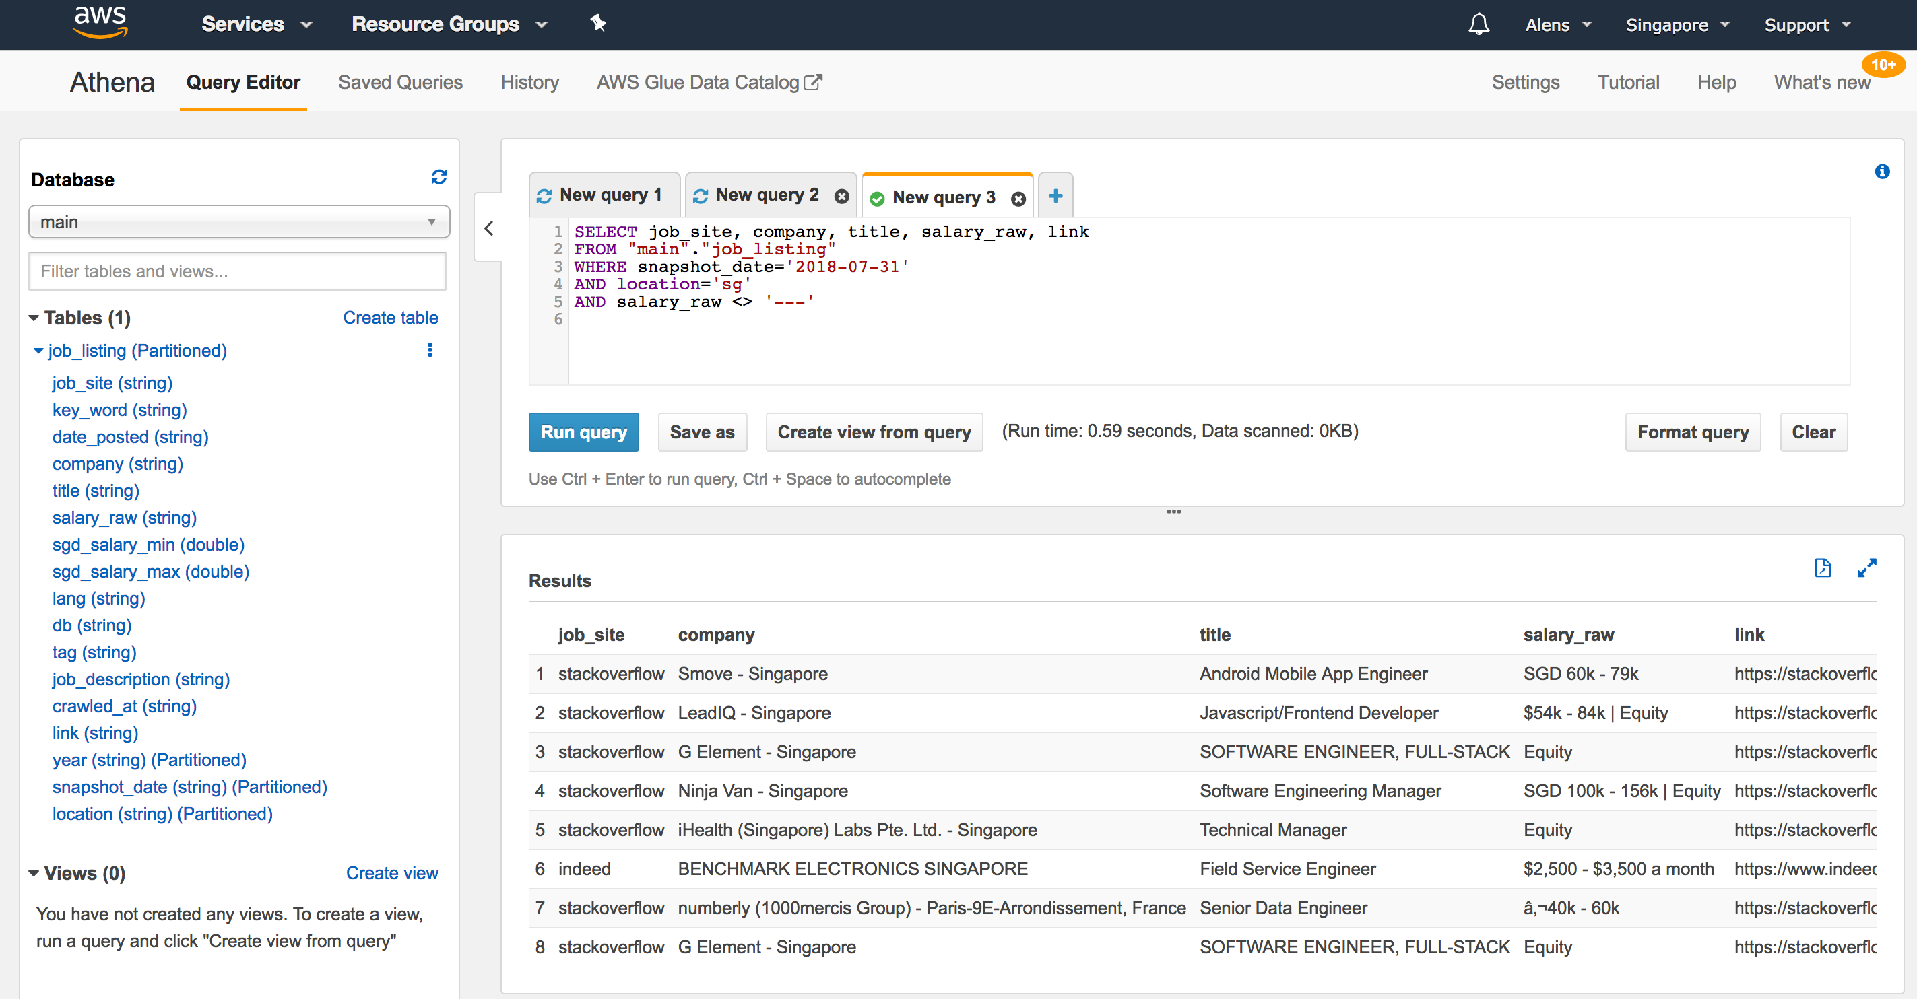

Slide 23
Apache Superset is
data exploration and
visualization web application

Slide 24
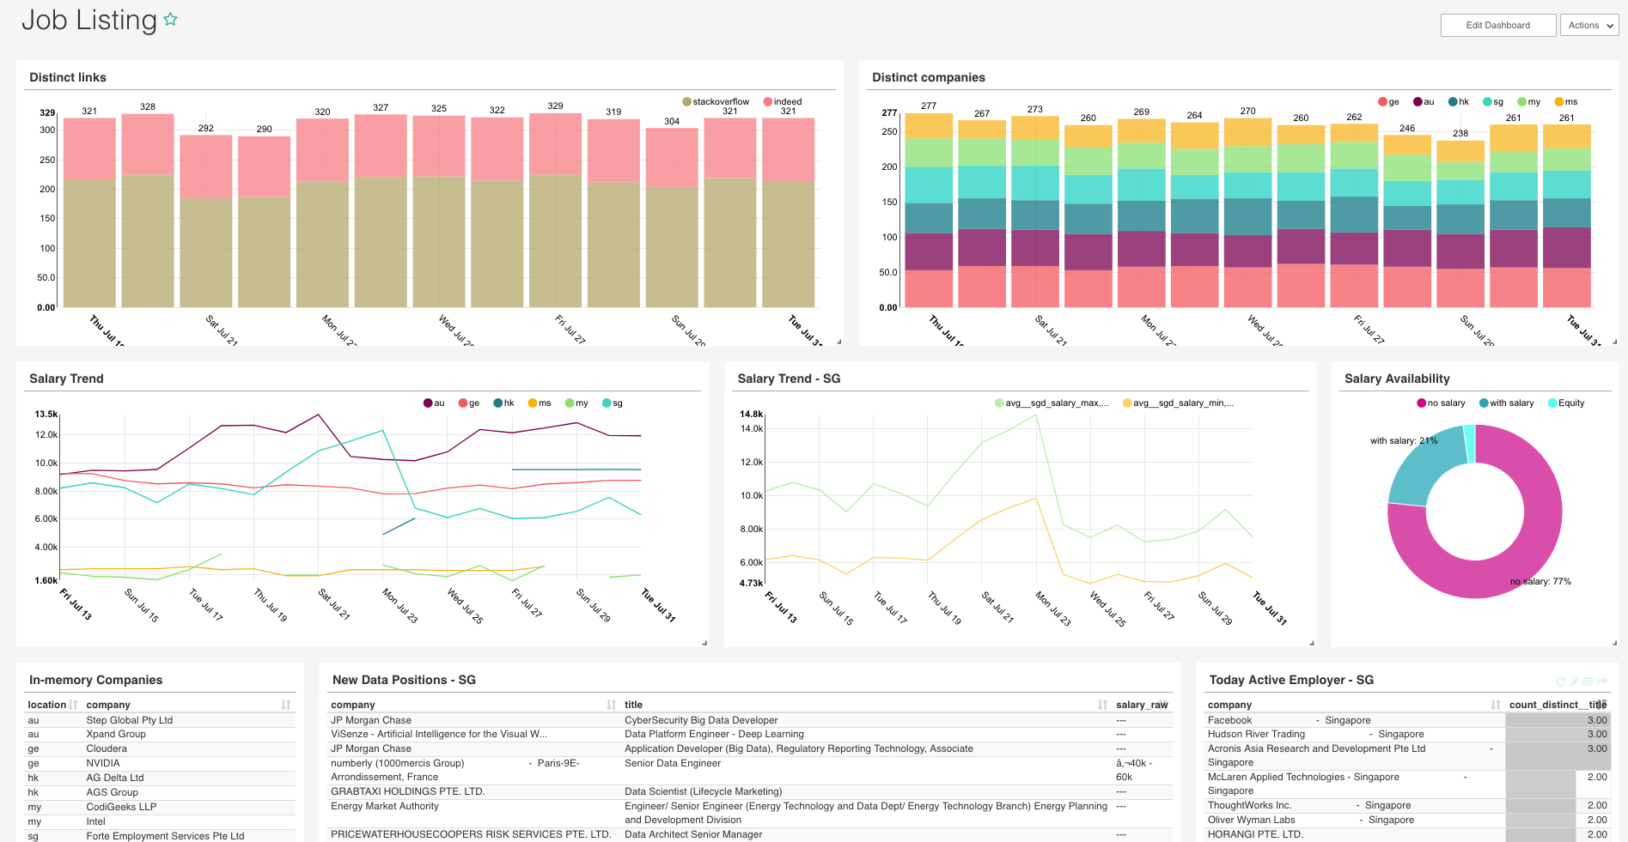

Slide 25
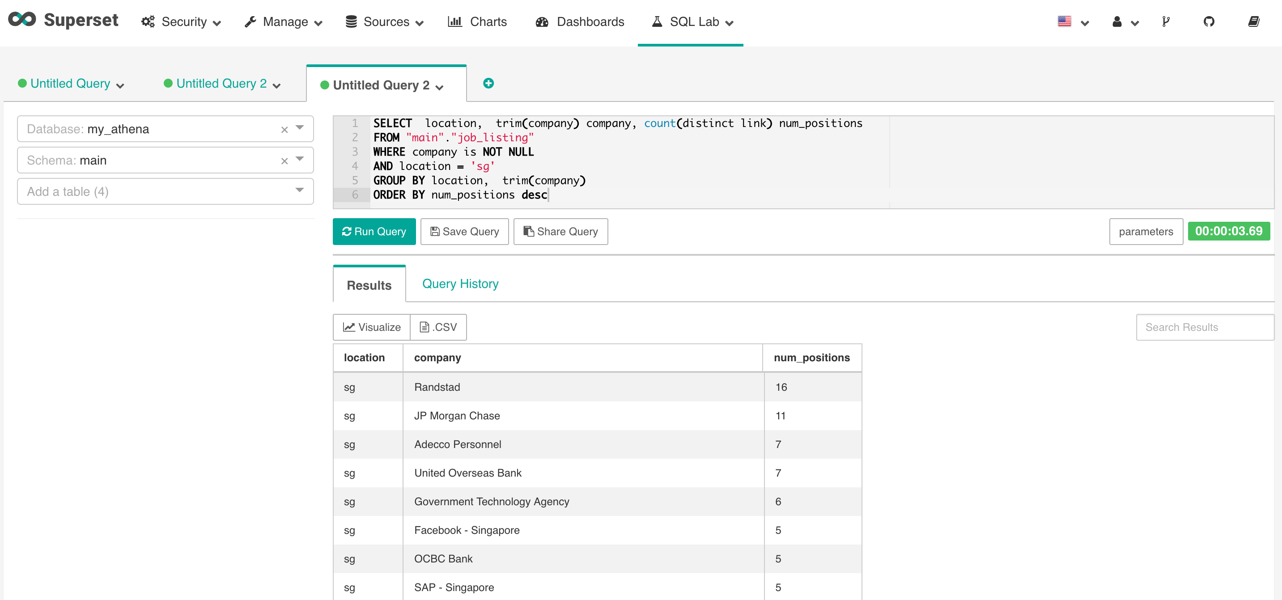

Slide 26
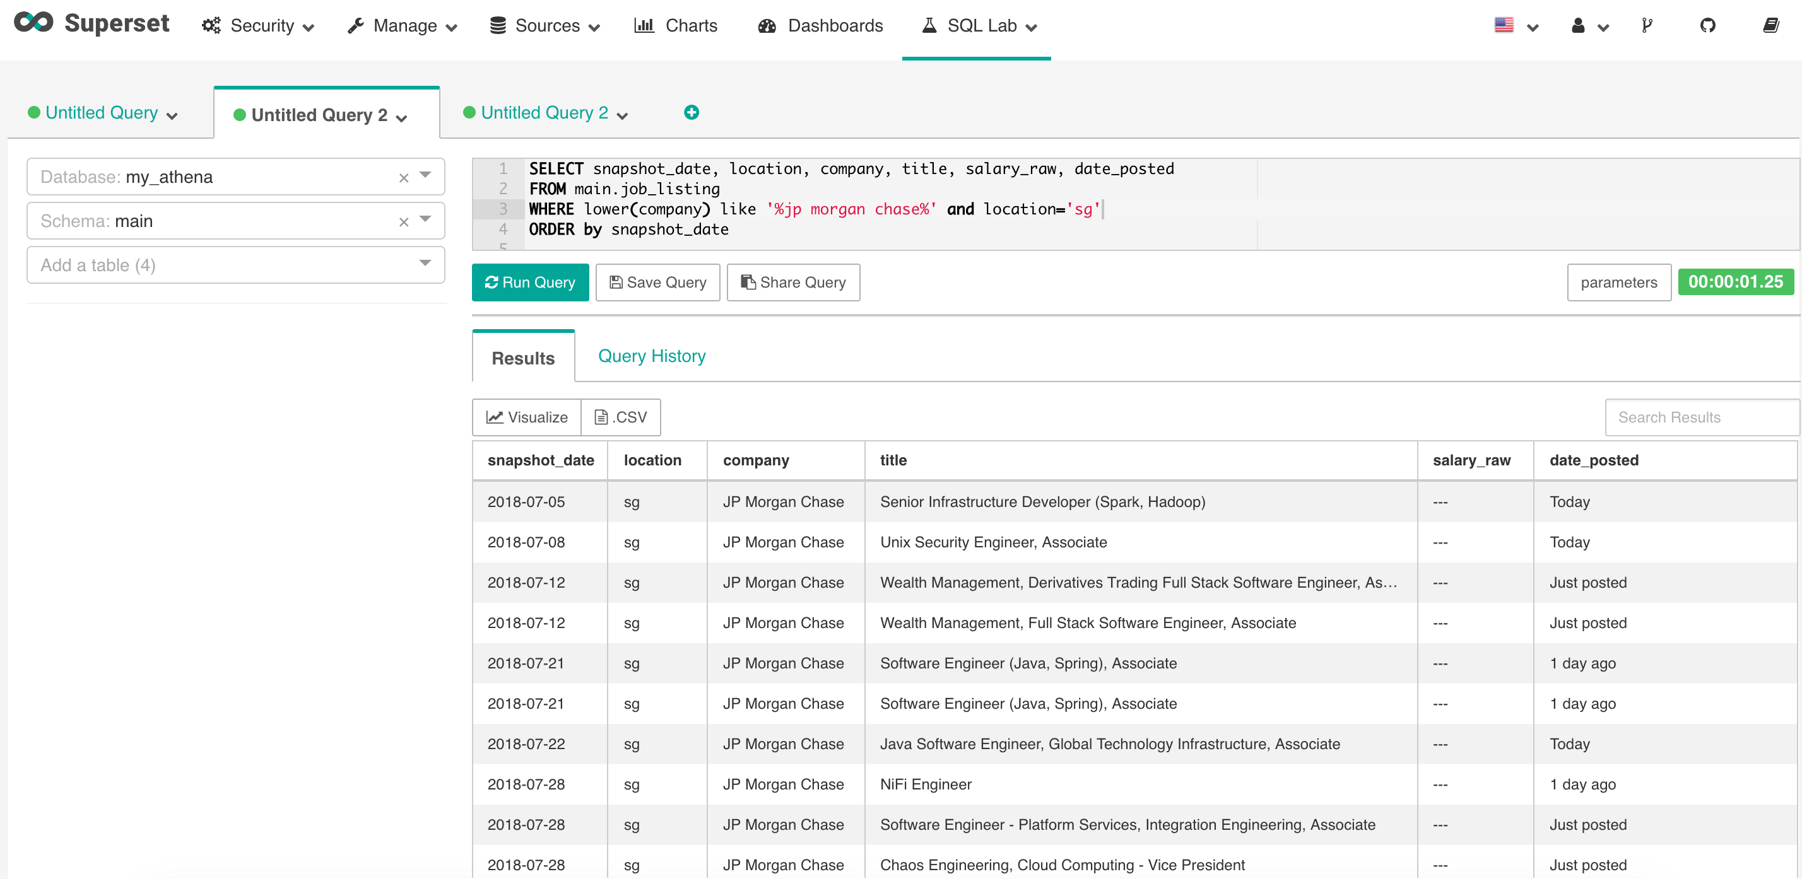

Slide 28
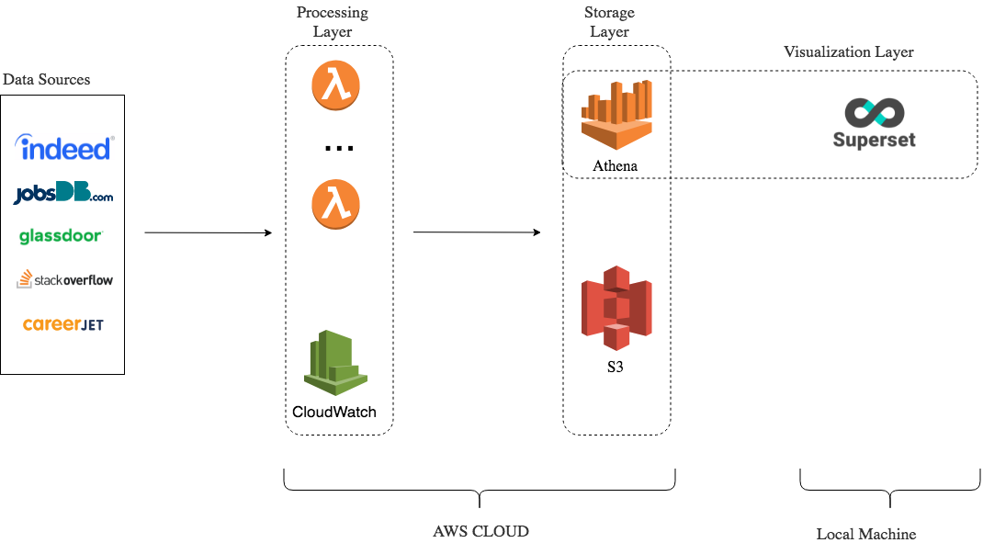
Pipeline Architecture 1.5
1 lambda function
6 CloudWatch schedulers
1 Athena table
1 Superset dashboard

Slide 29
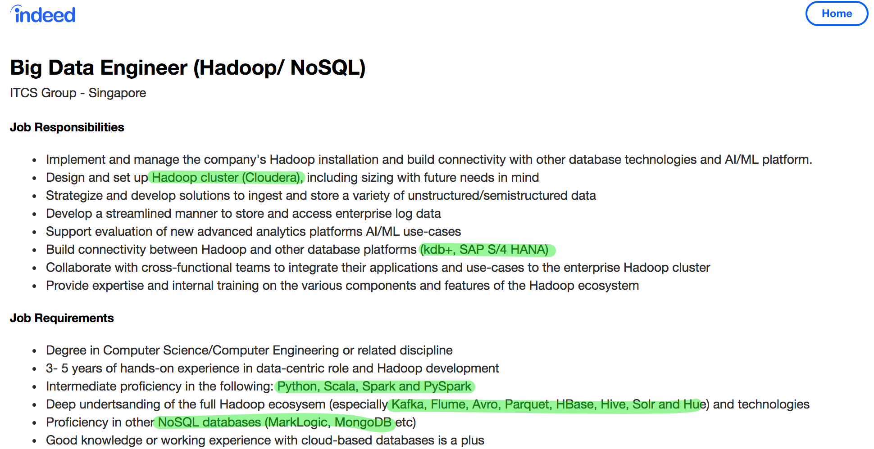
Named Entity Recognition (NER)
is a subtask of information extraction that seeks to locate and classify named entities in text into pre-defined categories such as the names of persons, organizations, locations, etc.

Slide 30
('you will have 5 years experience under your belt developing performance critical applications that run in a production environment using scala and or java',
{'entities': [(150, 154, 'LANG'), (137, 143, 'LANG'), (50, 57, 'DEVELOP')]})
('your responsibilities would include design implement and migrate existing sqlbased etls to spark based technology to achieve scale and performance',
{'entities': [(40, 46, 'ARCHITECT'), (95, 100, 'HADOOP')]})
('very good knowledge of sql preferably mysql',
{'entities': [(23, 26, 'LANG'), (38, 43, 'DB')]})
Named Entity Recognition (NER)
Labeling train dataset

Slide 31
('you will have 5 years experience under your belt developing performance critical applications that run in a production environment using scala and or java',
{'entities': [(150, 154, 'LANG'), (137, 143, 'LANG'), (50, 57, 'DEVELOP')]})
('your responsibilities would include design implement and migrate existing sqlbased etls to spark based technology to achieve scale and performance',
{'entities': [(40, 46, 'ARCHITECT'), (95, 100, 'HADOOP')]})
('very good knowledge of sql preferably mysql',
{'entities': [(23, 26, 'LANG'), (38, 43, 'DB')]})
Named Entity Recognition (NER)
Labeling train dataset

Slide 32
('you will have 5 years experience under your belt developing performance critical applications that run in a production environment using scala and or java',
{'entities': [(150, 154, 'LANG'), (137, 143, 'LANG'), (50, 57, 'DEVELOP')]})
('your responsibilities would include design implement and migrate existing sqlbased etls to spark based technology to achieve scale and performance',
{'entities': [(40, 46, 'ARCHITECT'), (95, 100, 'HADOOP')]})
('very good knowledge of sql preferably mysql',
{'entities': [(23, 26, 'LANG'), (38, 43, 'DB')]})
Named Entity Recognition (NER)
Labeling train dataset

Slide 33
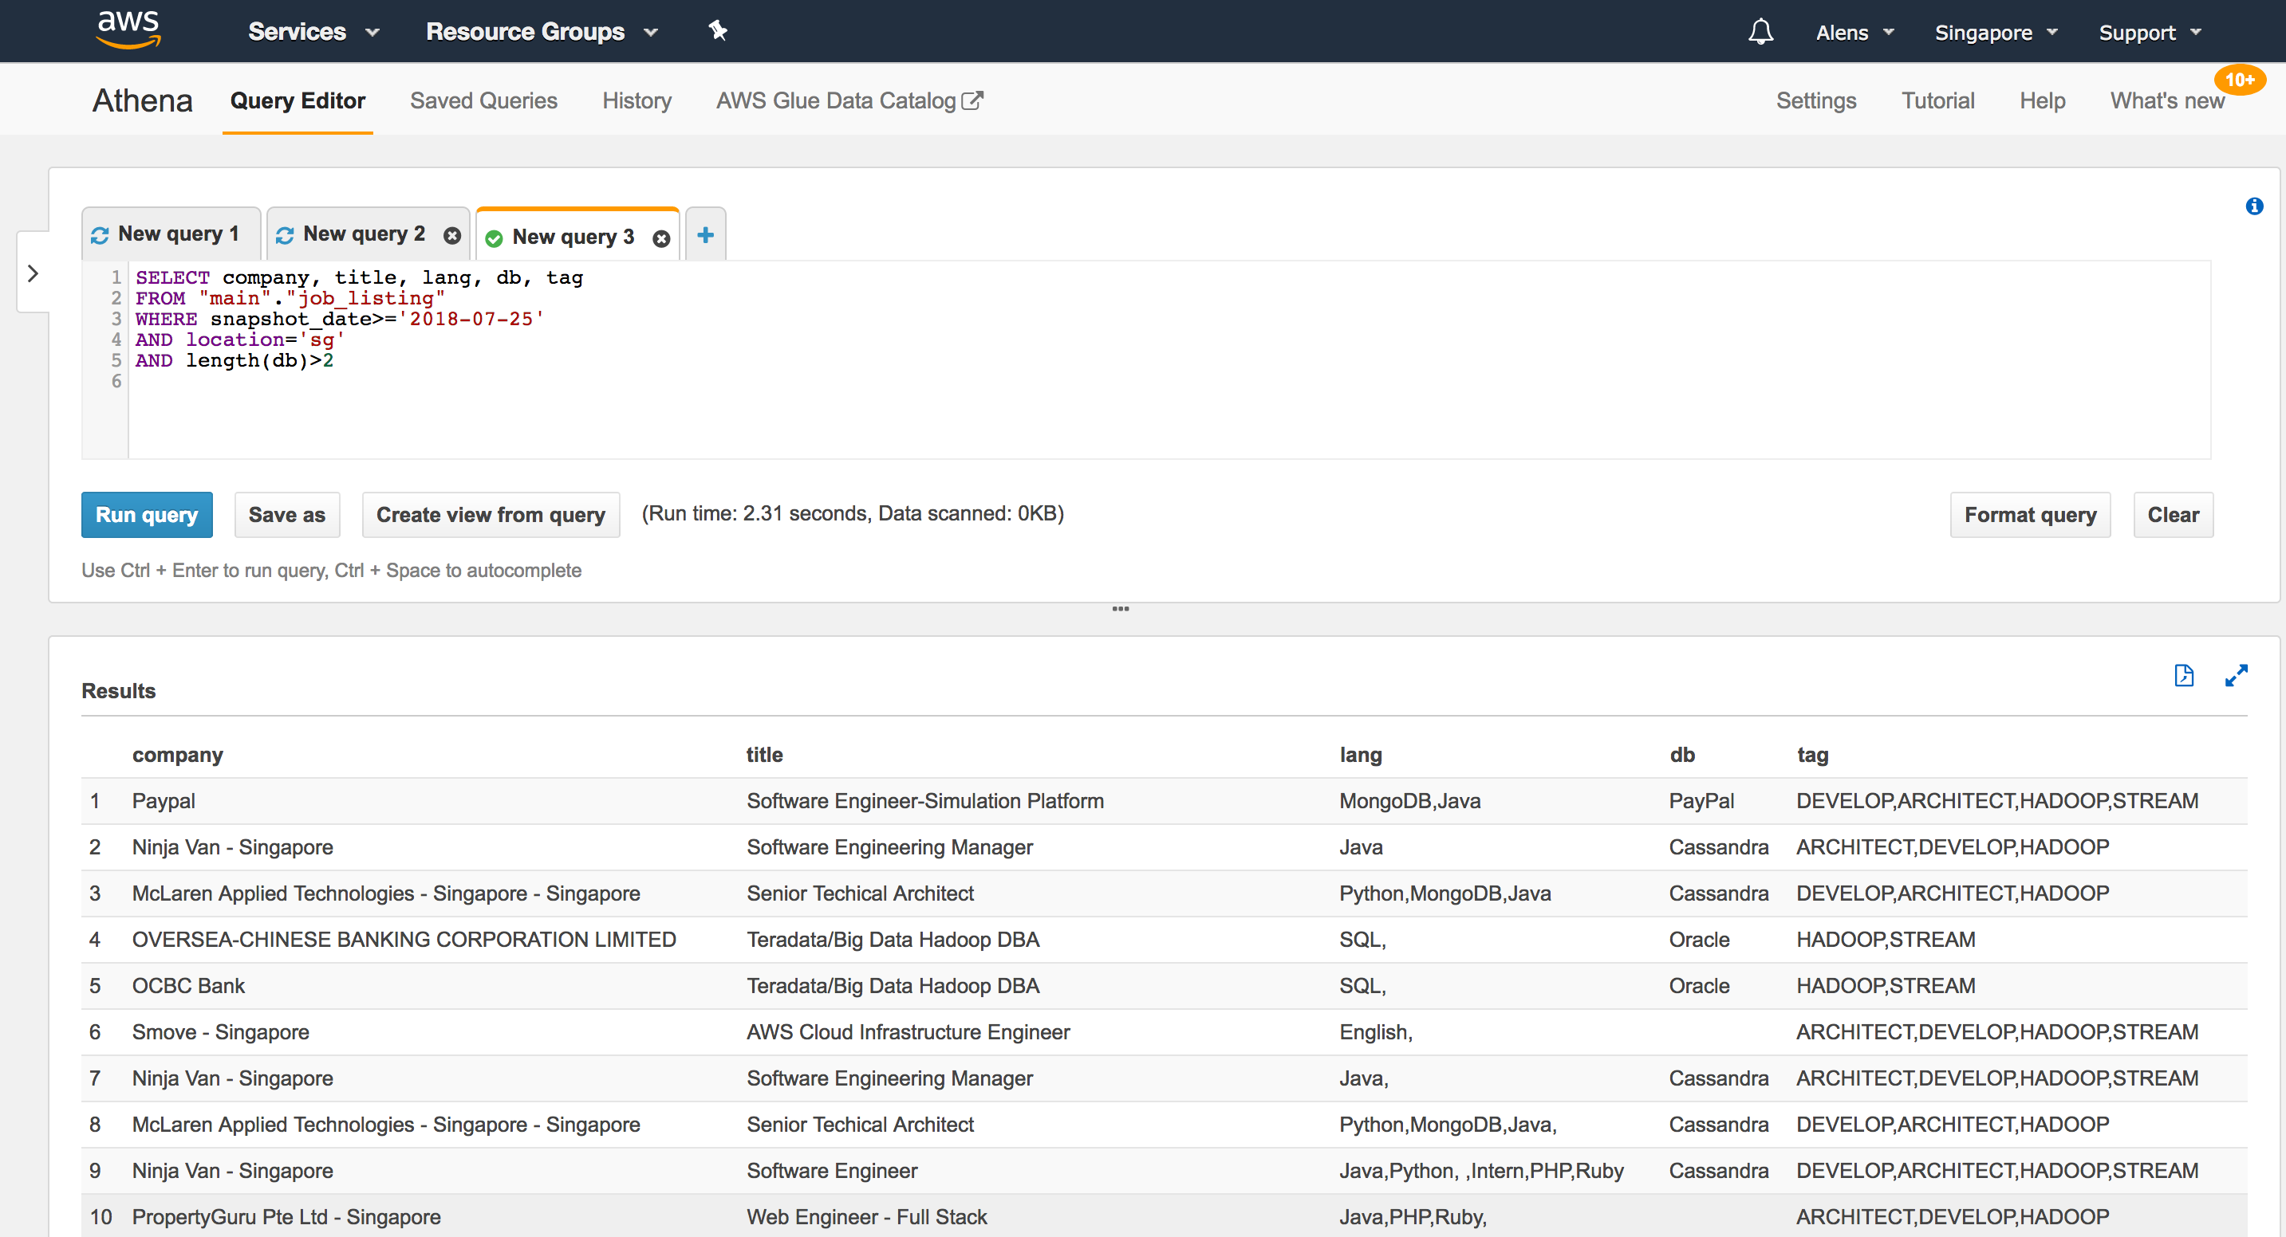

Slide 34
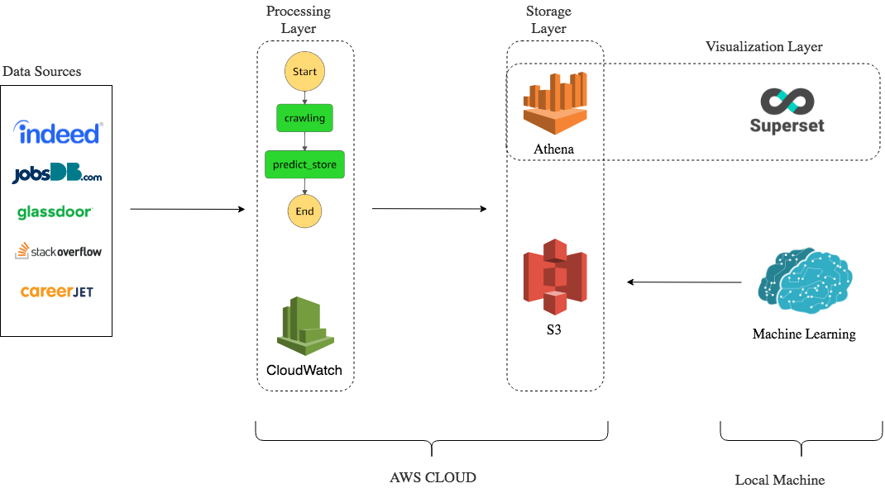
Pipeline Architecture 1.7
1 State machine
2 Lambda functions
6 CloudWatch schedulers
1 Athena table
1 Superset dashboard

Slide 35
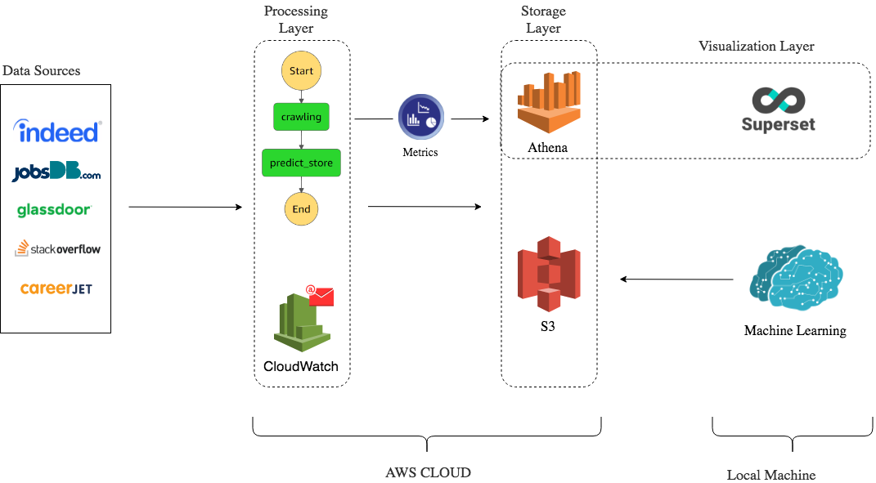
Pipeline Architecture 2.0
1 State machine
2 Lambda functions
6 CloudWatch schedulers + alerts
2 Athena tables
2 Superset dashboards

Slide 36
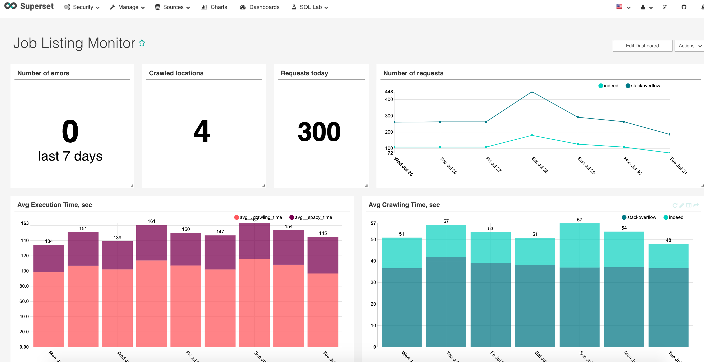

Slide 37
Pipeline Architecture 2.0
1 State machine
2 Lambda functions
6 CloudWatch schedulers + alerts
2 Athena tables
2 Superset dashboards

Slide 38
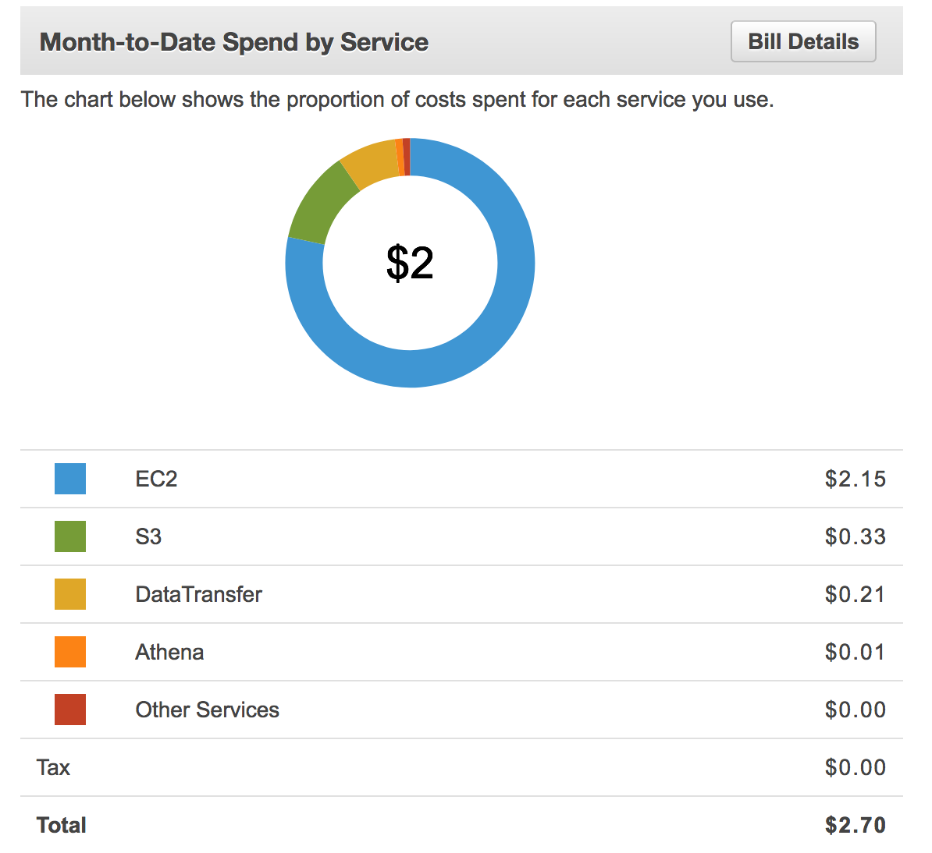
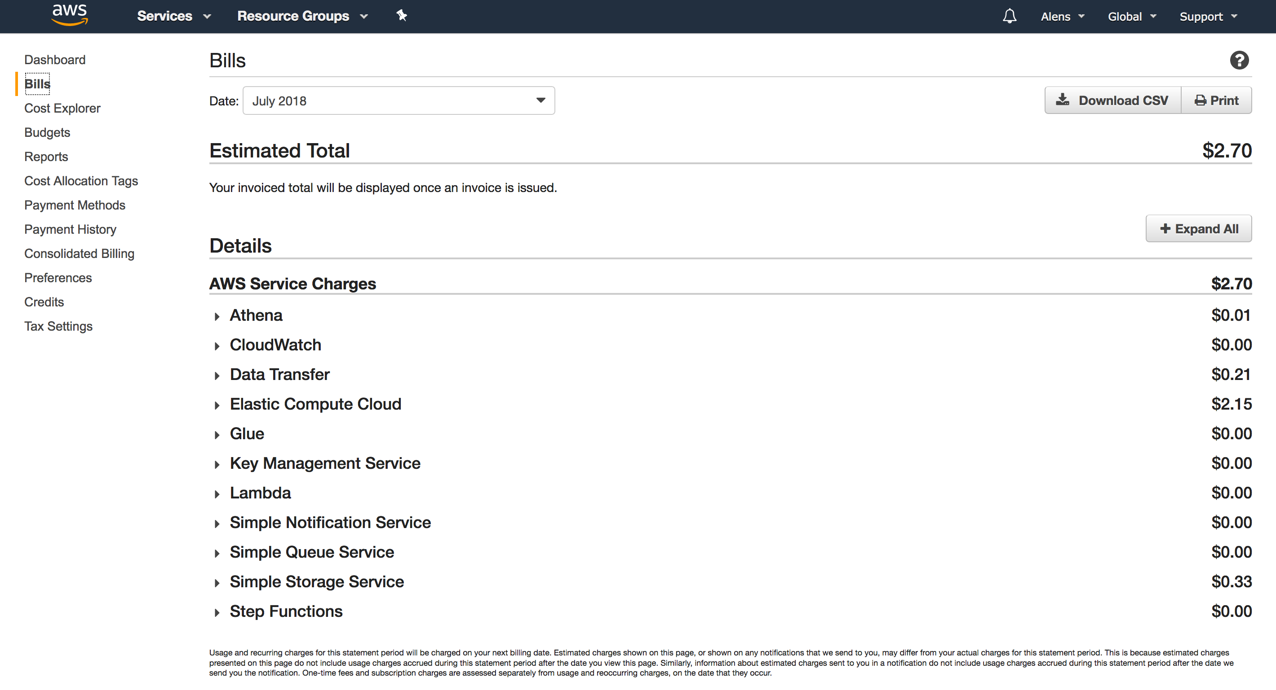

Slide 39
Useful links
Hacking the Data Science Interview
https://www.youtube.com/watch?v=3BRLGRqj8ps
Precompiled packages for AWS lambda
https://github.com/ryfeus/lambda-packs
The Free Currency Converter API
https://free.currencyconverterapi.com/
Comparison of NLP libraries
https://medium.com/activewizards-machine-learning-company/comparison-of-top-6-python-nlp-libraries-c4ce160237eb
THANK YOU

